Slide 1

Unit 10

Slide 2


To think about what kinds of things you worry about and who you go to for help and advice
To read a passage and know how Laura solves her worries
To talk about problems you face
To know the importance of solving problems rather than running away from them

Slide 3

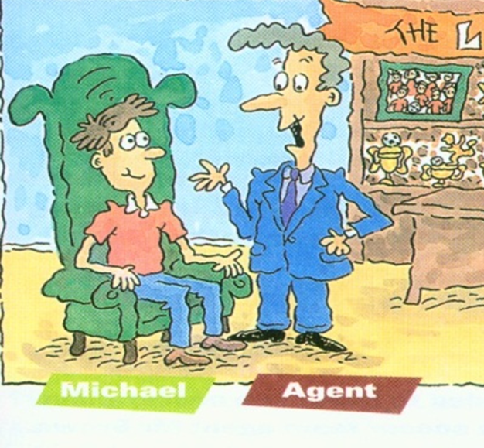

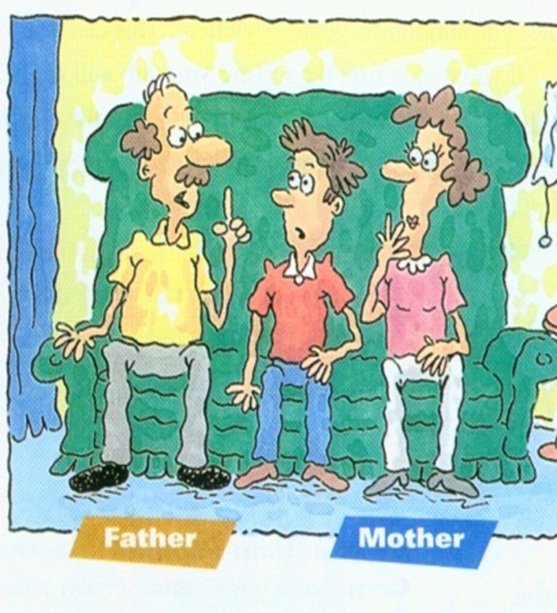
Make a conversation.
Michael: What do you think I should do? Can you give me some advice?
Friend: I think you should …
Michael: But if I …, I’ll …

Slide 4


expert n. 专家
teenager n. (13-19岁的)青少年
solve v. 劝告，解决
e.g. That expert may help teenagers solve their problems.
mile n. 英里
unless conj. (=if not) 除非；如果不
e.g. We were miles away from school. We’ll be late unless we go at once.

Slide 5
normal adj. 正常的；一般的
wallet n. 钱包
certainly adv. 无疑；肯定；当然；行
angry adj. 发怒的，生气的
keep…to oneself 保守秘密
e.g. It was a normal summer night, but something bad happened. I lost my wallet. Certainly, I was angry. What’s worse, I had to keep it to myself for a long time.

Slide 6
understanding adj. 善解人意的；体谅人的
careless adj. 粗心的；不小心的
careful adj. 小心的；细致的；精心的；慎重的
advise v. 劝告；建议
mistake n. 错误；失误
himself pron. 他自己
trust v. 相信；信任
e.g. Mr. Li is a very understanding person, but he himself is careless sometimes. I advise you to ask his sister. She is careful and seldom makes mistakes. You can trust her.

Slide 7
step n. 步；步骤
experience n. 经验（不可数）；经历（可数）
halfway adv. 在中途；部分地做 (或达到)
in half 分成两半
e.g. —What is the first step?
—Sorry, I don’t know. I have no experience at all.
— Certainly, we need help. Don’t stop halfway.
—I won’t. I’m going to surf the Internet. OK, get it! First, cut it in half.

Slide 8


Think about and answer the following questions.
4. Do you always tell your parents about your problems? (Why or why not?)
5. Do you ever give advice to your friends about their problems? (What advice do you give?)

Slide 10

Unit 10
If you go to the party,
you’ll have a great time!

Slide 11



Slide 12



Do you have problems with your schoolwork or your life? What kinds of things do you worry about?
finish homework as soon as you get home sleep as early as you can drink milk or have a foot bath before you sleep
can’t sleep well/ feel tired
have no close friends to talk to
can’t get along well with classmates/parents
don’t have enough time to do sports/something intrested
can’t get good marks in tests
feel nervous before exams
get heavy
Try to think of the solutions to the problems
by yourself or talk to someone you trust.

Slide 13
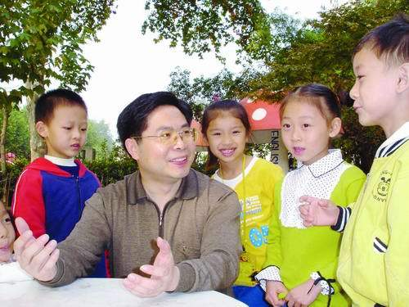



When you have such worries, who do you usually go to for help?
(go to sb for help 找某人帮助)
keep the worries to yourself?
an expert?
your good friends?
your parents?

Slide 14

How to solve the problems with the schoolwork or in life

Slide 15
Fast Reading
Read the passage quickly.
Underline the key sentences of each paragraph and try to get the main idea of each paragraph.
快速阅读文章，划出每段的中心句，获得每段的大意。

Slide 16

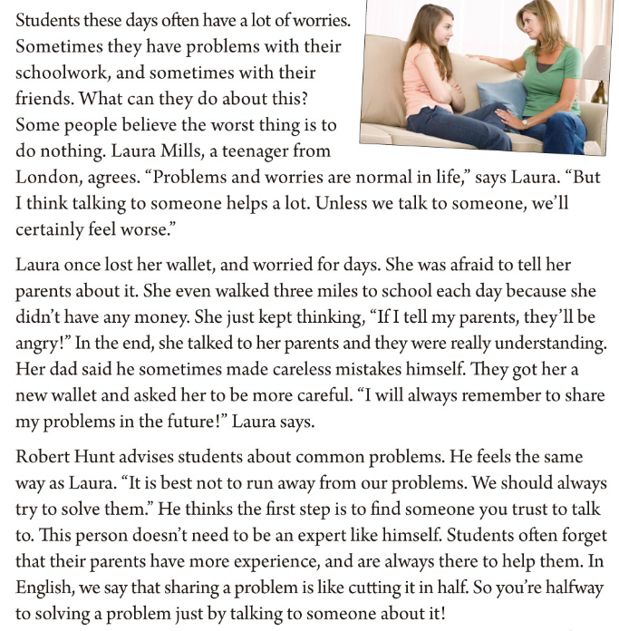

Slide 17
Paragragh 1
Students these days often have a lot of worries. Sometimes they have problems with their schoolwork, and sometimes with their friends. What can they do about this? Some people think the worst thing is to do nothing. Laura Mills, a teenager from London, agrees. “Problems and worries are normal in life,” says Laura. “But I think talking to someone helps a lot. Unless we talk to someone, we’ll certainly feel worse.”

Slide 18
Paragragh 1
Students these days often have a lot of worries. Sometimes they have problems with their schoolwork, and sometimes with their friends. What can they do about this? Some people think the worst thing is to do nothing. Laura Mills, a teenager from London, agrees. “Problems and worries are normal in life,” says Laura. “But I think talking to someone helps a lot. Unless we talk to someone, we’ll certainly feel worse.”

Slide 19
Paragragh 2
Laura once lost her wallet, and worried for days. She was afraid to tell her parents about it. She even walked three miles to school each day because she didn’t have any money. She just kept thinking，“If I tell my parents, they’ll be angry!” In the end, she talked to her parents and they were really understanding. Her dad said he sometimes made careless mistakes himself. They got her a new wallet and asked her to be more careful. “I will always remember to share my problems in the future!” Laura says.

Slide 20
Paragragh 2
Laura once lost her wallet, and worried for days. She was afraid to tell her parents about it. She even walked three miles to school each day because she didn’t have any money. She just kept thinking，“If I tell my parents, they’ll be angry!” In the end, she talked to her parents and they were really understanding. Her dad said he sometimes made careless mistakes himself. They got her a new wallet and asked her to be more careful. “I will always remember to share my problems in the future!” Laura says.

Slide 21
Paragragh 3
Robert Hunt advises students about common problems. He feels the same way as Laura. “It is best not to run away from our problems. We should always try to solve them.” He thinks the first step is to find someone you trust to talk to. This person doesn’t need to be an expert like himself. Students often forget that their parents have more experience, and are always there to help them. In English, we say that sharing a problem is like cutting it in half. So you’re halfway to solving a problem just by talking to someone about it!

Slide 22
Paragragh 3
Robert Hunt advises students about common problems. He feels the same way as Laura. “It is best not to run away from our problems. We should always try to solve them.” He thinks the first step is to find someone you trust to talk to. This person doesn’t need to be an expert like himself. Students often forget that their parents have more experience, and are always there to help them. In English, we say that sharing a problem is like cutting it in half. So you’re halfway to solving a problem just by talking to someone about it!

Slide 23



Listen to the passage.
Which statement expresses the main idea of the passage?
哪一个叙述表达了文章的大意？
a. If people have problems, they should get advice from an expert.
b. If people have problems, they should talk to other people.
c. If people have problems, they should keep them to themselves.

Slide 24

Read the passage carefully and answer the questions.
1. What is the worst thing to do if you have a problem?
2. Why didn’t Laura want to tell her parents about her lost wallet?
The worst thing is to do nothing.
Because she was afraid that her parents would be angry.
3. What is the first thing you should do when you want to solve a problem?
4. Why can our parents give us good advice about our problems?
The first step is to find someone you trust to talk to.
Because our parents have more experience than us, and are always there to help us.

Slide 25
Language Points
Students these days often have a lot of worries. Sometimes they have problems with their schoolwork, and sometimes with their friends. What can they do about this? Some people think the worst thing is to do nothing. Laura Mills, a teenager from Washington, agrees. “Problems and worries are normal in life,” says Laura. “But I think talking to someone helps a lot. Unless we talk to someone, we’ll certainly feel worse.”

Slide 26
Language Points
Laura once lost her wallet, and worried for days. She was afraid to tell her parents about it. She even walked three miles to school each day because she didn’t have any money. She just kept thinking，“If I tell my parents, they’ll be angry!” In the end, she talked to her parents and they were really understanding. Her dad said he sometimes made careless mistakes himself. They got her a new wallet and asked her to be more careful. “I will always remember to share my problems in the future!” Laura says.

Slide 27
Language Points
Robert Hunt advises students about common problems. He feels the same way as Laura. “It is best not to run away from our problems. We should always try to solve them.” He thinks the first step is to find someone you trust to talk to. This person doesn’t need to be an expert like himself. Students often forget that their parents have more experience, and are always there to help them. In English, we say that sharing a problem is like cutting it in half. So you’re halfway to solving a problem just by talking to someone about it!

Slide 28
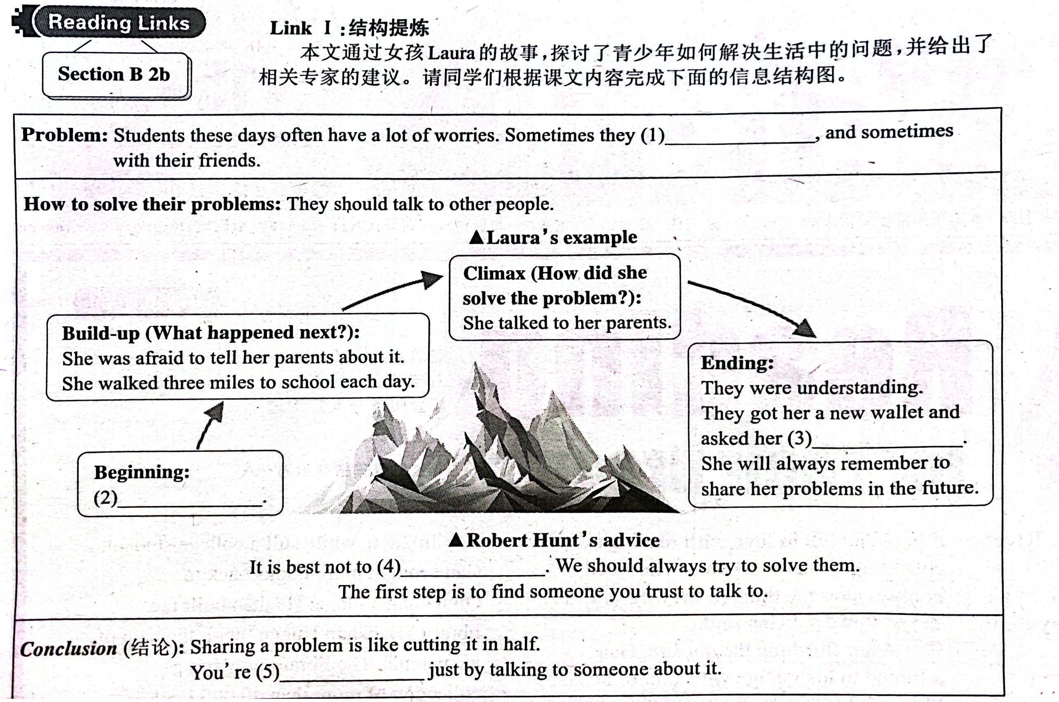
have problems
with their schoolwork
to be more careful
She once lost
her wallet
run away from
our problems
halfway to
solving a problem

Slide 29

Fill in the blanks with the phrases in the box.
discuss your problems tell her parents unless you talk
run away from talk to someone share her problems to do nothing
Students often have a lot of problems and worries. Laura Mills thinks the worst thing is _____________. She thinks you’ll feel worse if you don’t ______________ about your problems.
to do nothing
talk to someone
Laura remembers that she once lost her wallet and was afraid to _______________ about it. Now she believes you cannot feel better _____________ to someone. She says she will always __________________ in the future. Robert Hunt agrees with Laura.
tell her parents
unless you talk
share her problems
run away from
He thinks you should not _____________ your problems, but you should try to solve them. If you cannot talk to an expert like Robert, you can ______________________ with your parents because they have a lot of experience.
discuss your problems

Slide 31


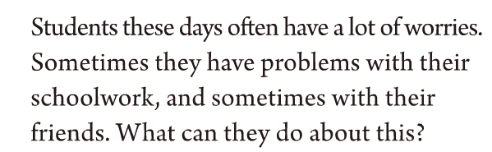
Read the first three sentences and try to predict what the passage is about.

Slide 32

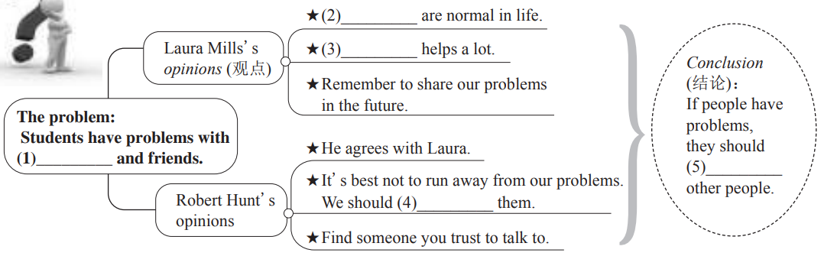
Problems and worries
Talking to someone
their schoolwork
talk to
try to solve

Slide 33
Read the statements. Are they facts or opinions?
fact
Students these days often have a lot of worries.
Problems and worries are normal in life.
Laura once lost her wallet, and worried for days.
Robot Hunt advises students about common problems.
It’s best not to run away from our problems.
Students always forget that their parents have more experience.
You’re halfway to solving a problem just by talking to someone about it!
opinion
fact
fact
opinion
fact
opinion

Slide 34
Names | Question 1 | Question 2 | Question 3 | Question 4 | Question 5
Then choose a question to report your findings to the class.

Slide 35


从……得到建议
保守秘密
在……方面有问题
不敢做某事
最后
犯错
躲开；回避
get advice from ...
keep ... to oneself
have problems with ...
be afraid to do sth.
in the end
make mistakes
run away from
尽力做某事
分成两半
完成或做了事情的一部分
有丰富的经验
try to do sth.
in half
be halfway to doing sth.
have a lot of experience

Slide 36


I. 根据语境，从方框中选择恰当的单词填空, 注意形式变化。
normal, wallet, travel, he, else,
experience, step, solve, certainly, care
1. After leaving school, Laura spent a year __________ around the world.
2. Take this bag and leave something __________ to me.
3. After she paid for the meal, she put the receipt (收据) in her __________.
4. How __________ Robert was! He forgot his keys again.
traveling /
travelling
else
wallet
careless

Slide 37
normal, wallet, travel, he, else,
experience, step, solve, certainly, care
5. He lives all by _________ in that large house.
6. Peter’s room was not tidy, but that was quite _________.
7. —Can you help me?
—_________.
8. Do you have any _________ of working with kids?
9. Susan thinks money will _________ all her problems.
10. If you want a strong (强壮的) body, please follow these _________.
himself
normal
Certainly
experience
solve
steps

Slide 38
II. 根据汉语意思及括号内所给英文提示语，将下列句子翻
译成英语。
1. 我生他的气了， 他让我等这么久。 (angry with ... for ...)
2. 你可以相信我，因为我是你的朋友。 (trust)
3. 我这些天牙齿有问题。 (have problems with)
I was angry with him for keeping me waiting so long.
You can trust me because I’m your friend.
I have problems with my teeth these days.

Slide 39
4. 如果你不是太累的话，让我们去散步吧。 (unless)
5. 我建议他去看医生。 (advise)
Let’s go for a walk unless you’re too tired.
I advised him to go to / see the / a doctor.

Slide 40


Read the passage again after class.
Write a short paragraph about the worries of your friends. You can use the information in 2e.

Slide 41


